Slide 1
Admissions Update
&
Enrollment Goals
Brian Troyer
Dean, Undergraduate Admissions

Slide 2
Goals for the day:
Ask and answer as many questions as you’d like
Give you an insider’s look into how and why we do what we do
Introduce myself and the Office of Undergraduate Admissions as a resource
To thank you, and talk about ways you can meaningfully engage with our office, and make a difference in the lives of future Golden Eagles.
Question 1:
What do you hope to learn more about in the next hour?

Slide 3
The National Picture for Higher Education

Slide 6
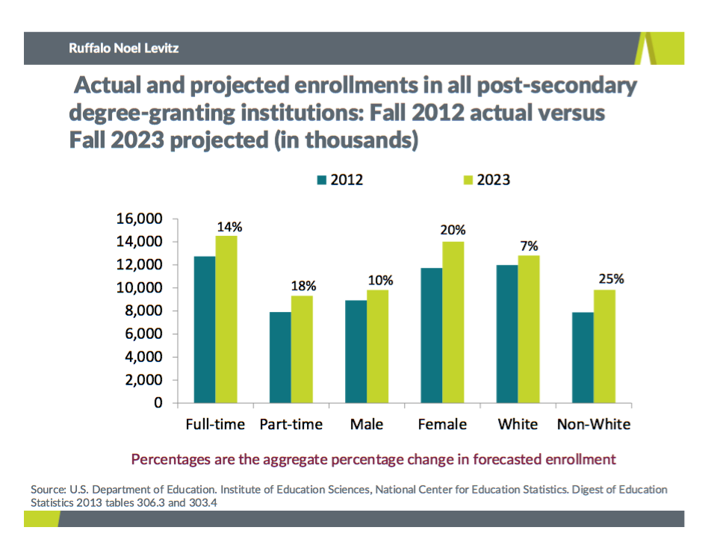

Slide 7
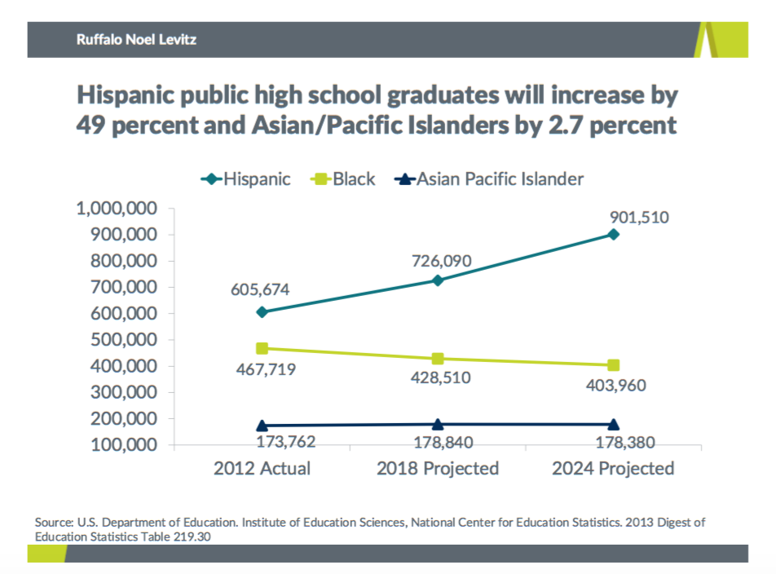

Slide 8
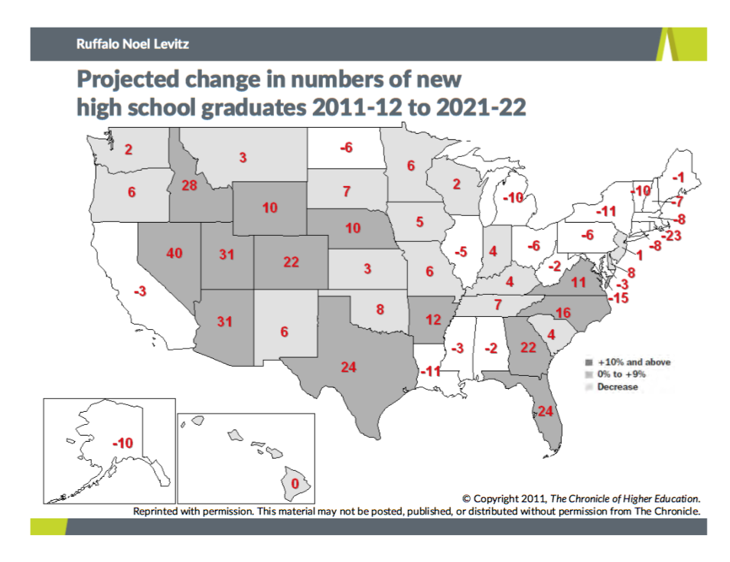

Slide 9
Notes:
In addition to being central to our mission, identity, and diversity goals, the reality of the demographic shifts both nationally and locally necessitates a look toward the Hispanic community.
According to the latest data from WICHE (Dec. 6, 2016), or the Western Interstate Commission on Higher Education, now is exactly the right time to be focusing on the diversification of our campus.
Because while the overall number of high school graduates is expected to plateau over the next decade, the share of these students who are students of color will increase.

Slide 10
Question 2:
What are other trends you are noticing among the high school population?
Question 3:
What can you do to ensure a stable enrollment future for Marquette?
Question 4:
What should we (Admissions) be doing to respond to these trends?

Slide 11
Marquette Admissions:
Current Snapshot

Slide 13
Fall 2017 Cohort
Goal: 2025 first-year students; 170 transfers
As of 1/18/17:
13,432 submitted applications (-1%)
11,960 completed applications (-1%)
10,519 admitted (+5%)
757 denied (-12%)
416 waitlisted
69 deposited (+47%)

Slide 14
Fall 2017 Cohort, cont’d
Admitted a few weeks earlier
Academic profile at or slightly above previous years
First class experiencing Prior-Prior Year (PPY)
Received Financial Aid packages 1-2 months ahead of previous years
Will be required to attend SPARK (Summer Priority Advising & Registration Kickoff)

Slide 15
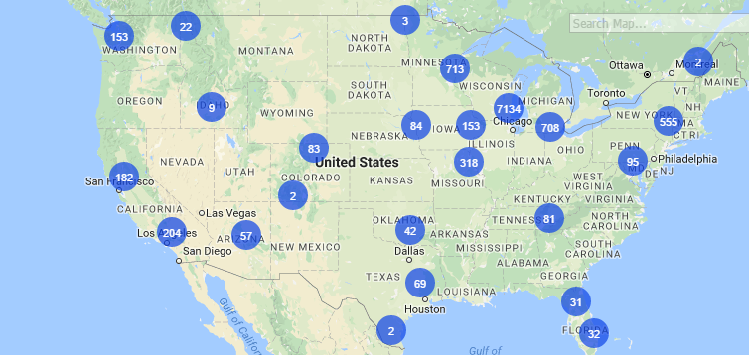
Fall 2017 Admits

Slide 16
Question 5:
What are you willing to do to help us recruit the Class of 2017?
Question 6:
When someone asks you about Marquette, what do you highlight?

Slide 17
Marquette Admissions:
Looking Ahead

Slide 18
Challenges
Demographics:
National
Midwest, Illinois, & Wisconsin facing similar trends
Increasing…
Competition
Price
Expectations

Slide 19
Opportunities
Marquette is a national brand
Enrollment stability is a strength
Catholic, Jesuit High Schools
Growth in Hispanic high school graduates
Transfers
International Students
A diverse array of academic offerings (see CPG)

Slide 20
Opportunities
Enrollment Management reorganization
Campus partner collaboration
A strong national brand recognized for cultivating student success and producing outstanding graduates
Alumni engagement

Slide 21
Territory Management Strategy
We are more data-driven than we have ever been before.
Regional Counselors
A national strategy, and a national presence:
Jesuit and Catholic schools
Direct alumni engagement (i.e. Boston)

Slide 22
Our Vision
To be closely aligned with Marquette’s mission
To continue a legacy of strong academics, proud traditions, and producing successful alumni
Build a class of 2,000+ freshmen & 170+ transfer students one student at a time.

Slide 23
Question 7:
What are the perceptions of Marquette where you live, and
what can/should Admissions do to change, enhance, or confront those perceptions?

Slide 24
A Look Ahead…
Rolling admissions
New yield strategies
Yield Receptions
More admitted student events
Individualized, meaningful communication
Increased focus on transfer and international students
Changing our search and recruitment models

Slide 25
My biggest request?
The best predictor of enrollment?
Has the student visited campus
Yield rate (admission to enrolled) for Fall 2016 was:
All admits? 18%
Took a tour? 36%
Shadow visit? 45%
Scholarship Competition? ~50%
Admitted Student Day? 55%

Slide 26
Thank you!
Our best advertising is you;
94% of graduating students said they would do it all over again;
In short, thank you!
And while you’re doing your part, I promise I’m doing mine…

Slide 27
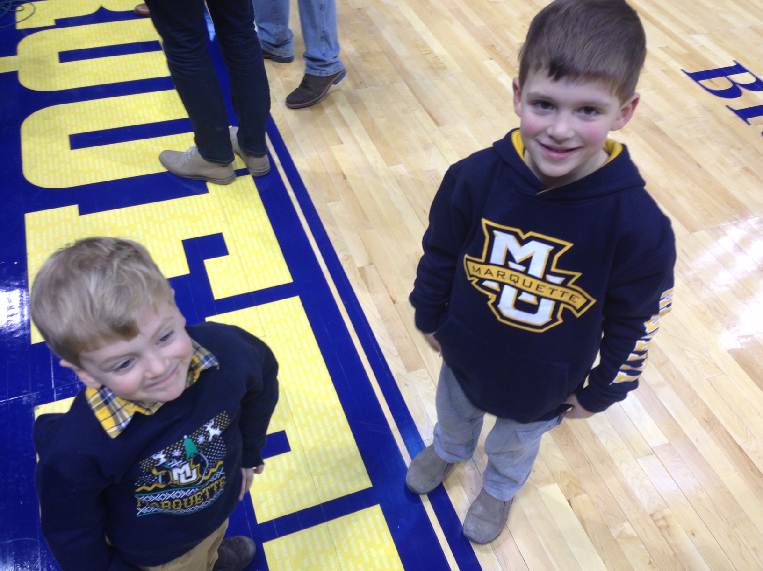
Charlie:
Class of 2030
Henry:
Class of 2032

Slide 28
Questions?
Brian Troyer
Brian.Troyer@marquette.edu
414.288.7004
Zilber Hall, 136

